Slide 1

Diabetes Prediction
ASHISH JOSHI
JEEVAN BUDHA

Slide 2
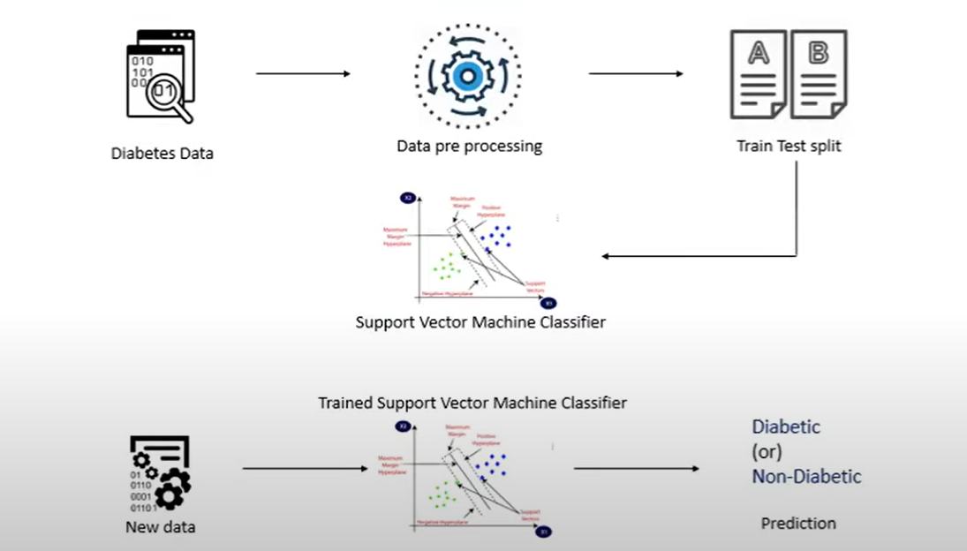
WORK FLOW

Slide 3
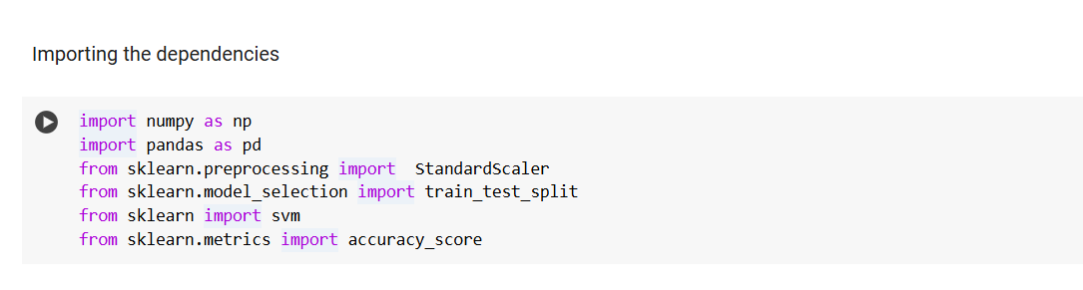
Import the libraries

Slide 4
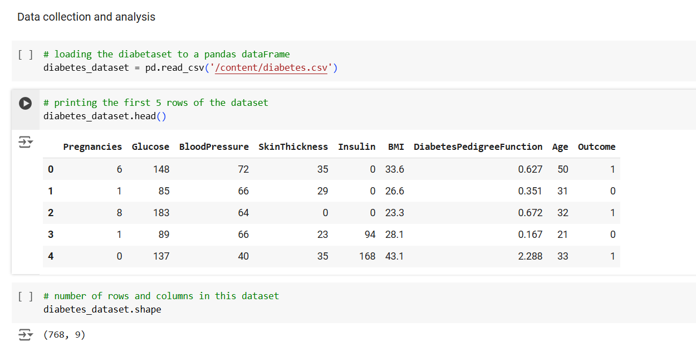
Data collection and Analysis

Slide 5
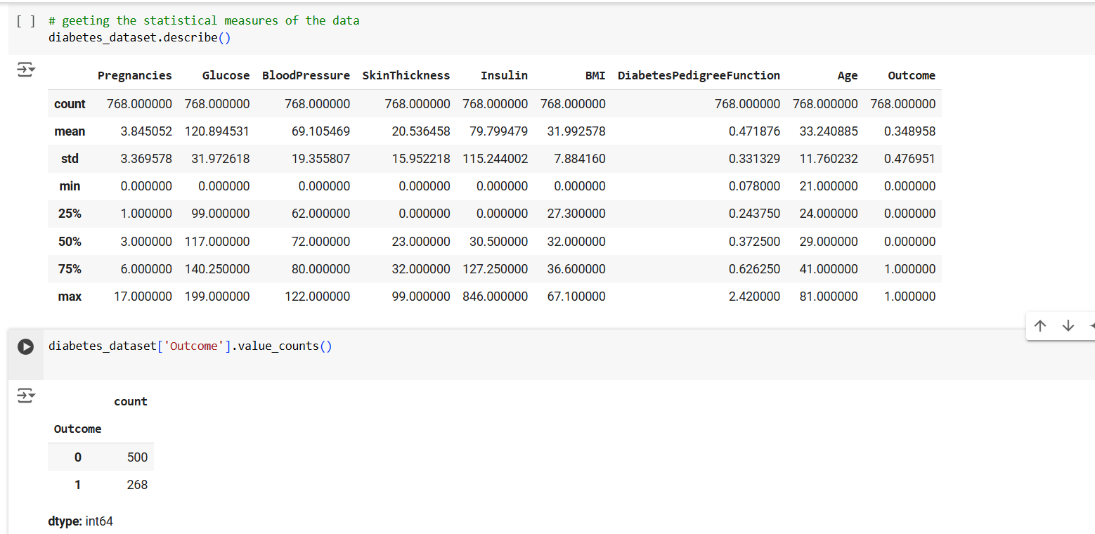
Statistical measures of this data frame 0--> Non-Diabetes 1-->Diebetes

Slide 6
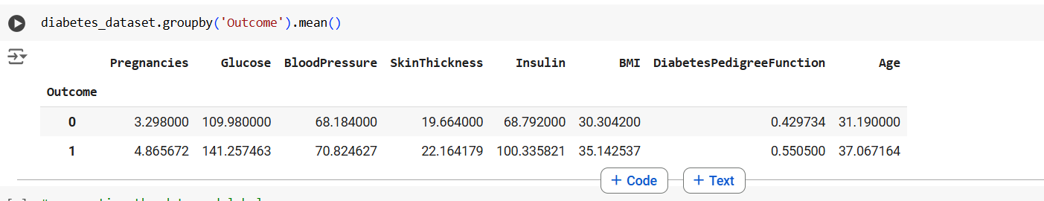
Get the mean for all those value for this label zero and one

Slide 7
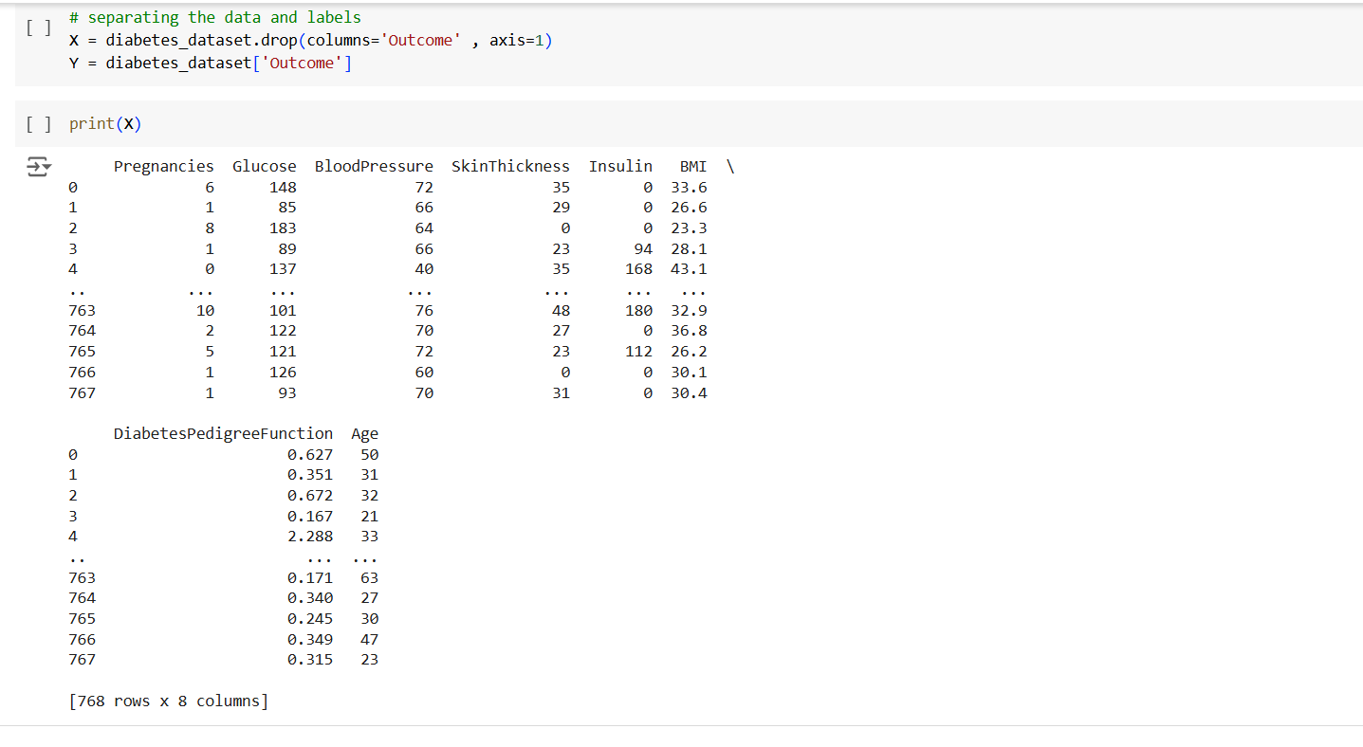
Separate the data and label print (x)

Slide 8
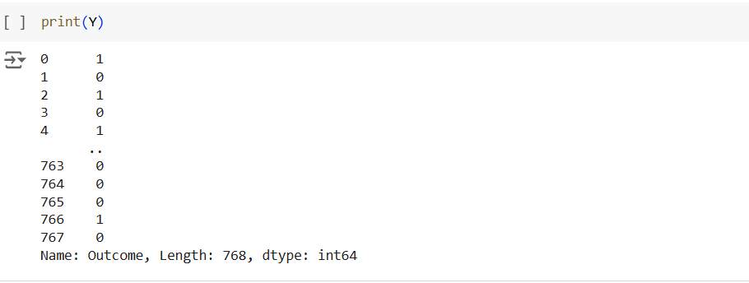
Print (Y)

Slide 9
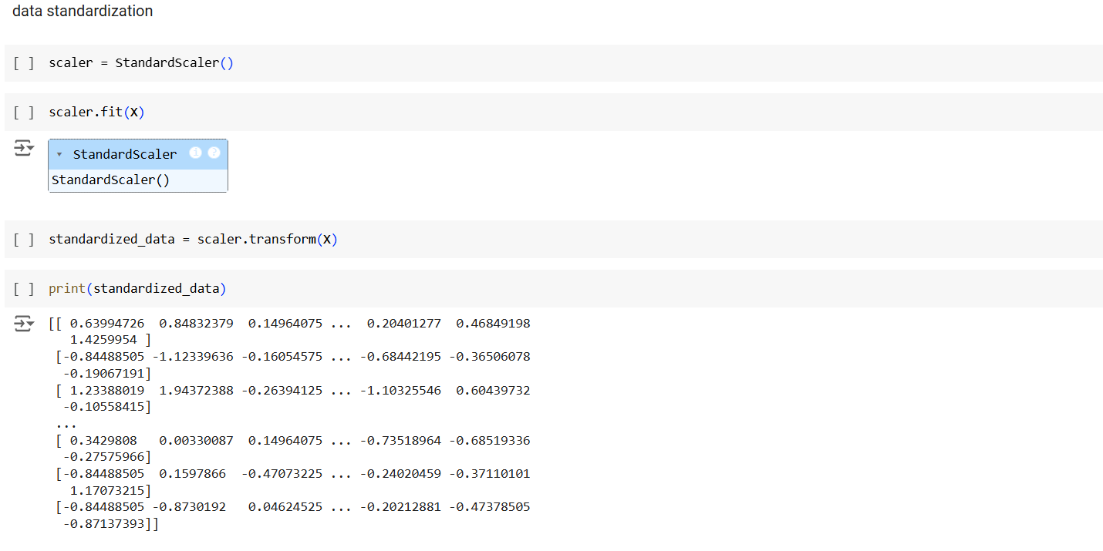
Data standardization

Slide 10
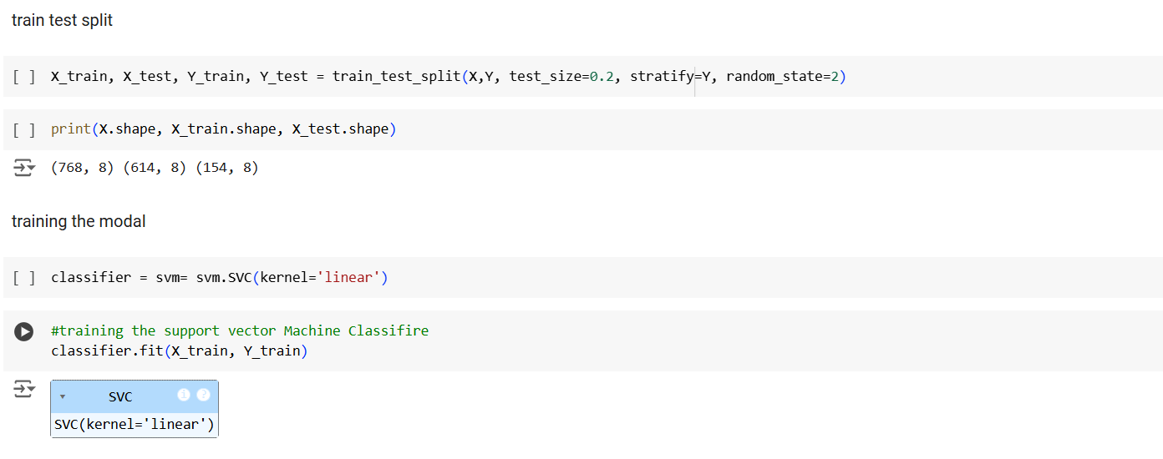
Train test split

Slide 11

Thank you

